Slide 1


GPS TOLL SYSTEM SIMULATION
Developing a GPS-based toll system
simulation using Python

Slide 2
Brief solution about the
problem statement:
Develop a GPS-based toll system that adjusts toll rates dynamically based on real-time traffic conditions, vehicle type, and road usage. This system aims to optimize traffic flow, reduce congestion, and ensure fair pricing.

Slide 3
Features Offered:
Real-Time Traffic Monitoring:
Dynamic Toll Rates:
Seamless Toll Collection:
User Notifications and Navigation:
Data Analytics and Reporting:
Emergency and Priority Access:

Slide 4
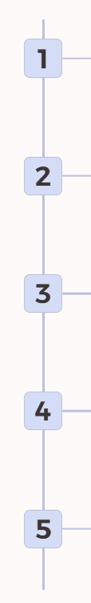
Process flow :
Distance calculation
by entering source and destination calculate distance
Vehicle Detection
Identify vehicles entering the system
Toll Calculation
Calculate tolls based on distance
Payment Processing
Process transactions securely
Transaction Logging
Record all transactions

Slide 5
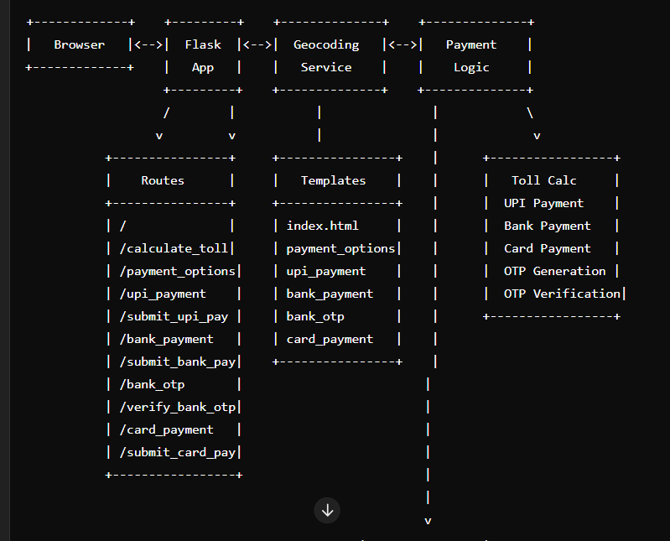
Architecture Diagram :

Slide 6
Technologies used :
Backend: Flask, Geopy, Math, Random, Time, Python
Frontend: HTML, JavaScript (optional), CSS (optional)
Protocols: HTTP/HTTPS, WSGI
External Services: Nominatim (Geocoding), Payment Gateways
Security: Encryption (optional), Access Control (optional)
These technologies collectively provide a robust solution for dynamically calculating tolls based on real-time data and facilitating various payment methods.

Slide 7
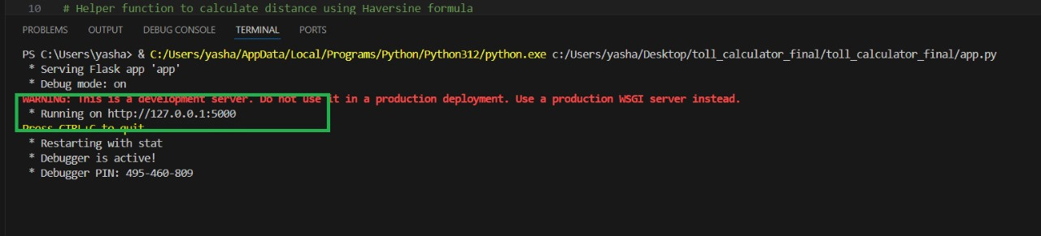
How to run the program :
after running running the program in vs code we will get a link
copy the link and run in any browser

Slide 8
Conclusion :
The provided code implements a comprehensive GPS-based toll system using Flask as the backend framework. It integrates several technologies and services to achieve its functionality: Flask handles HTTP requests, routing, and rendering HTML templates for user interactions; Geopy is utilized for geocoding city names to obtain their coordinates, essential for calculating travel distances; the Haversine formula is employed to compute distances between geographic coordinates. Additionally, the system integrates with external payment gateways for processing UPI, bank, and card payments, enhancing user convenience. This solution effectively demonstrates how modern web technologies and external services can be combined to create a dynamic, user-friendly toll calculation and payment platform.

Slide 9

Presented by :
SAKSHI S BIDI
GM INSTITUTE OF TECHNOLOGY
DAVANGERE

Slide 10
THANK YOU

